Slide 1
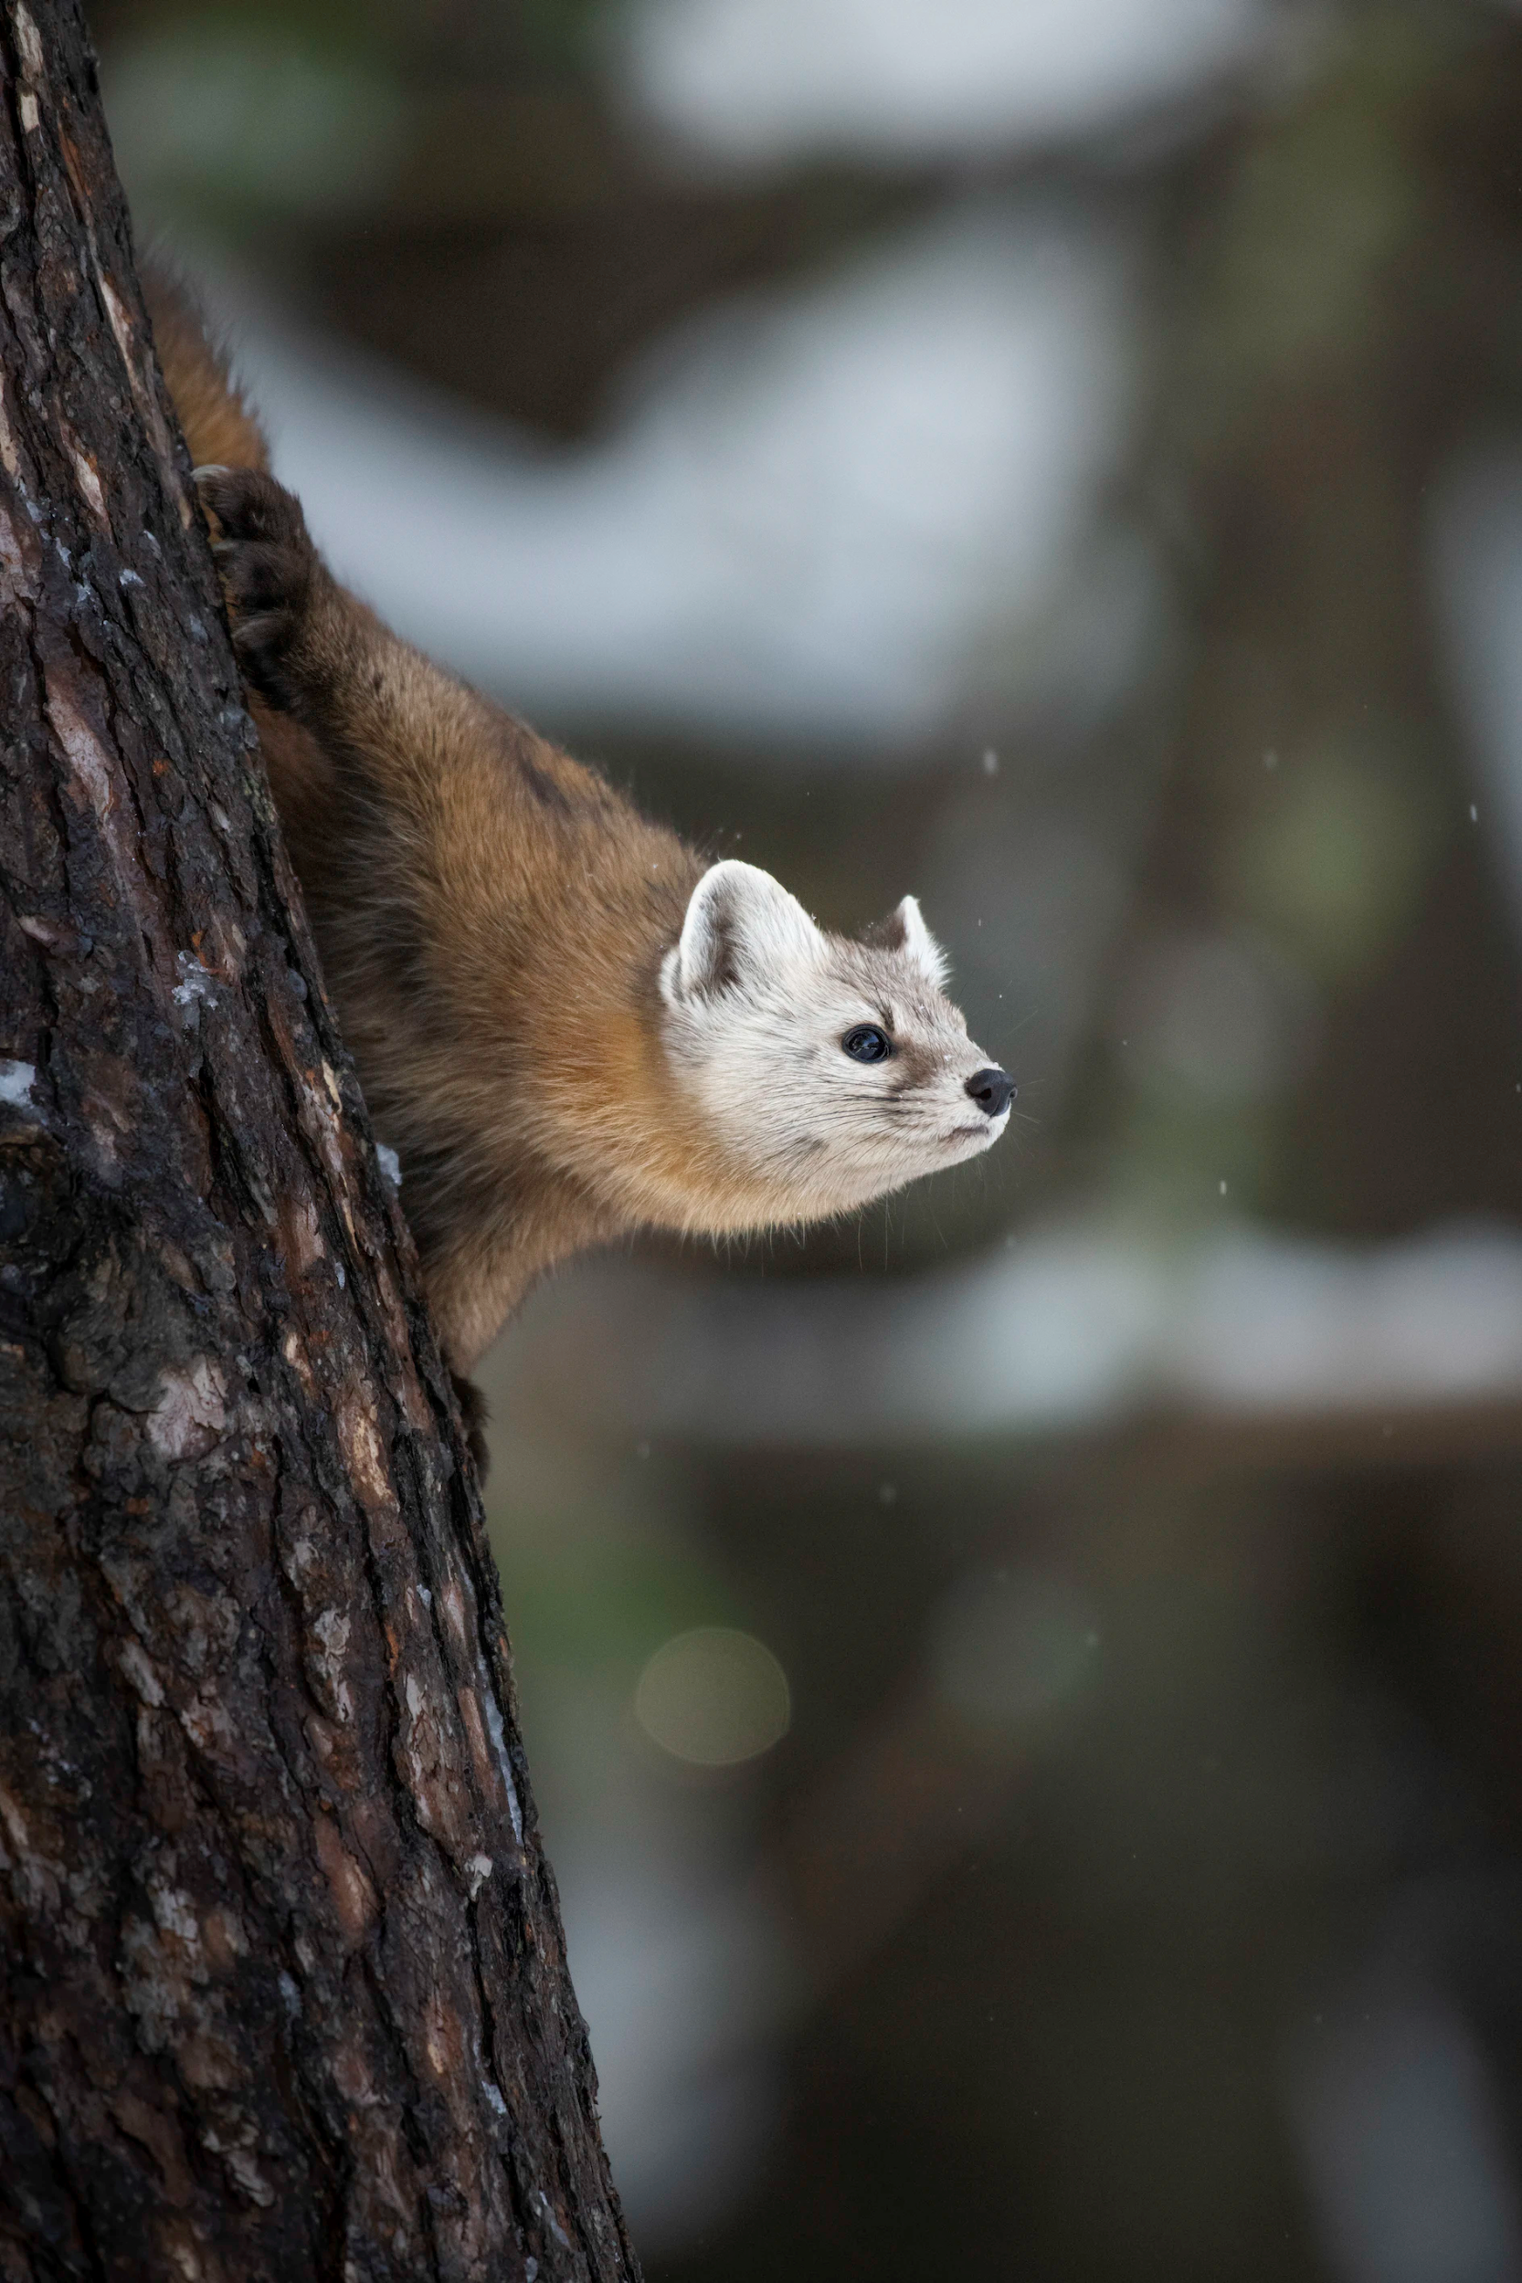
ANIMALS IN FOLKLORE
Multilabel classification with ecological features in folklore

Slide 2

Task Specification / Annotation Goal
Identify the roles of flora and fauna cross-culturally
Are these flora/fauna archetypally similar enough that we can identify their roles cross-culturally?
Are there universal roles?
Notes:
Autumn

Slide 3
Raw Data
Japanese: Okazaki - Project Gutenberg
Filipino: pitt.edu
Seneca: Project Gutenberg & nativelanguages.org
Maori: Official Maori Website
Cherokee: Northern Cherokee Nation Website
Notes:
Autumn
The goal is for data to come from sources originating from the culture, like pulling indigenous stories from indigenous websites. We didn’t always do this, though, Arabian Nights has been telephoned through many cultures by the time it reached project gutenberg.

Slide 4
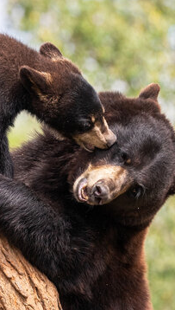
FOLKTALES DATASET:
122 folktales from 5 nations
Pre-processing: pre-tagged flora/fauna
Classified tales from around the world:
Cherokee
Japanese
Maori
Filipino
Seneca
Notes:
Ben

Slide 5
Evolution of Annotation Goal / Guidelines
Detecting all archetypes and mapping their triggers
Simplifying the archetypes and removing triggers
Simplifying to solely focus on pre-tagged roles and alignments
Notes:
Chris

Slide 6
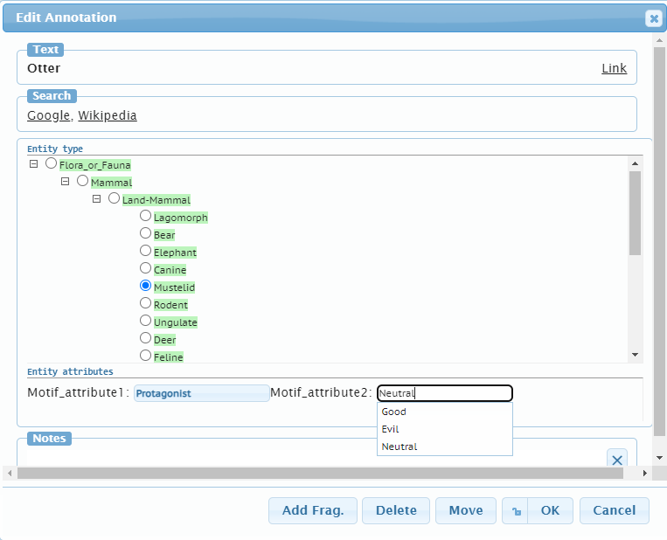
Final Version of Annotation Goal / Guidelines
Tag each type of flora/fauna with the following attributes:
Role
Protagonist
Antagonist
Default
Alignment
Good
Evil
Neutral
Notes:
Ben

Slide 7
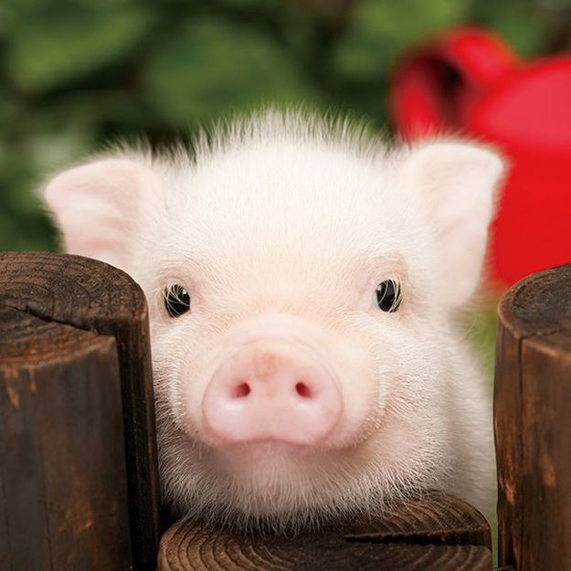
Annotations
Tagging neutral vs not tagging, missing animals (ex: if there was a pig & a deer, both were ‘ungulates’ & annotatoes would often only notice 1 of them)
Notes:
Ben

Slide 8
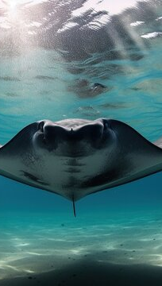
IAA Methodology
Spans were pre-annotated
Technically we could compare which specific tag the annotators gave attributes
Tabulated all of the annotations for flora/fauna in each document for agreement
Found cases where tags were not labeled
Also many neutral cases, we considered not counting these as well
Notes:
Chris

Slide 9
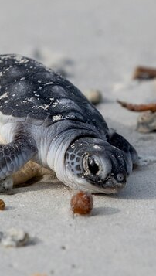
IAA Statistics
Cohen’s kappa
Raw dually annotated data: basically 0
Filtering cases where one annotator missed a tag: role = .66, alignment = .58
Further filtering default, neutral, and None cases: role = .33, alignment = .15
Notes:
Chris

Slide 10
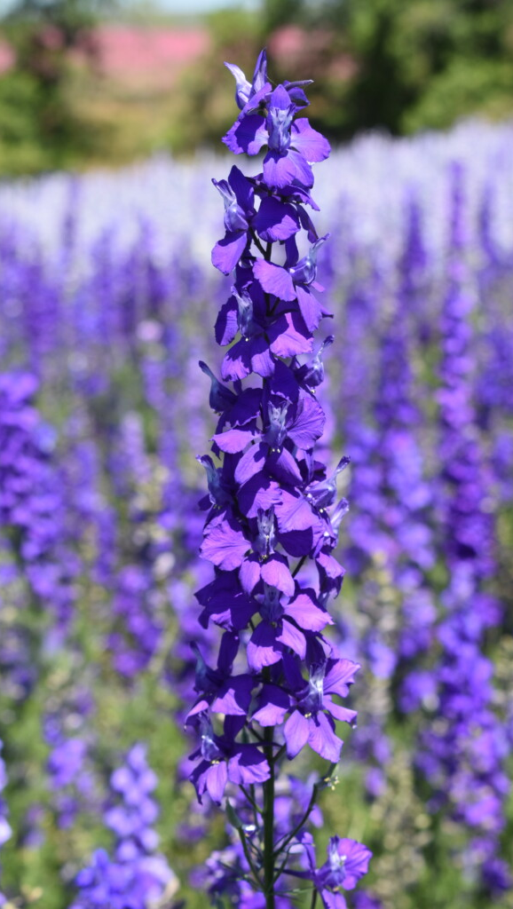
More Statistics
For improvement -> we could change span size or how we count neutral, look at bias per culture, collect more data from more stories
Notes:
Chris

Slide 11
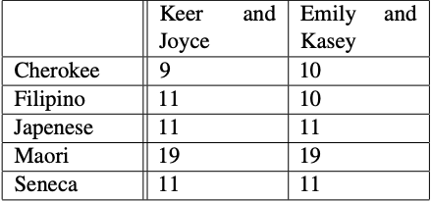
Adjudication
Pick an annotator for a template for the gold data
Who annotated more tags total?
Who tended to pick better tags to label with attributes?
Default to one annotator if the other skipped it
Resolve other annotator disagreements ourselves, reviewing the guidelines
Japanese
Notes:
Ben

Slide 12
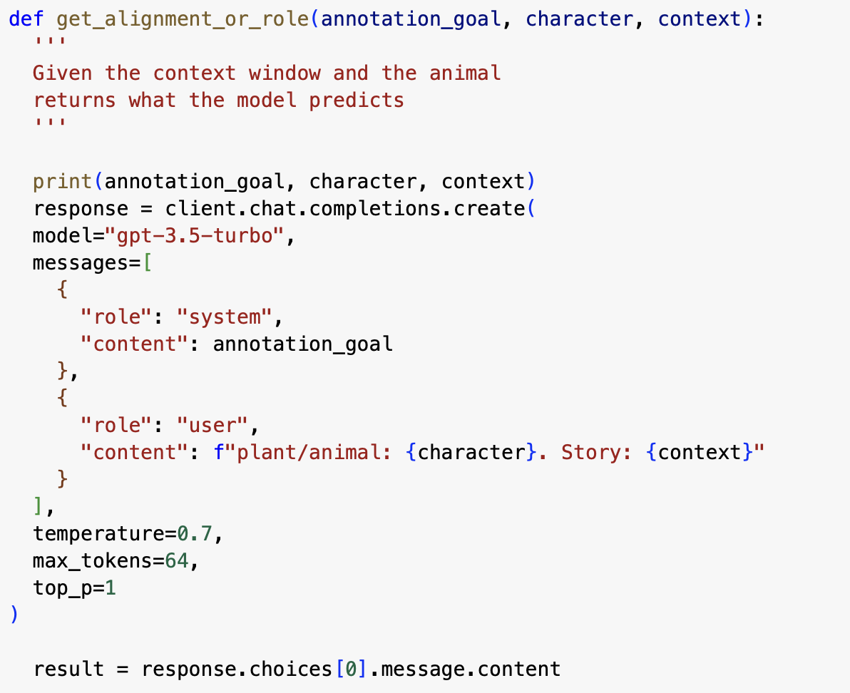
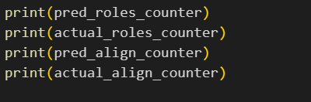
Machine Learning Baseline
Prompting LLM: Chat GPT 3.5 turbo
results:
Alignment accuracy = 44%
Role accuracy = 36%
Notes:
Ben, Autumn

Slide 13
Additional Takeaways
Complexity of literary analysis of machine learning and annotation
Complex guidelines
How to simplify what you are working on
Working on this allowed us to uncover ways to simplify, like a necessary evil
Notes:
Ben, others

Slide 14
Additional Takeaways
High level takeaways - many new routes, two of many examples: -Trees were almost never protagonists/characters but appeared often. Why? What are their roles? -Some cultures lead w/evil protagonists → a trend we could track geographically?
Notes:
Ben, others

Slide 15
Additional Takeaways
Later goals for this project: -High protagonist/antagonist/neutral agreement, but low good/bad/evil agreement. Could be a curious study to expand upon - was it guidelines or is this a potential trend?
Notes:
Ben, others

Slide 16
Left Field Twist…
-Autumn tweeted this project & now goes viral every time she touches Twitter
-About 120,000 views & 2500 likes total in the past 3 days
Notes:
Ben, others

Slide 17
Why? Real Life Takeaway!
Going to apply these methods w/Boston Children’s/Harvard Med, who are already doing similar work w/discharge notes
Notes:
Ben, others

Slide 18
Who is watching?
Caught attn of Publishing, Writing, Folklore & English Professor twitter
Journalists watching from BBC & Business Insider
Harper Collins & Four Literary agents now pressuring her write trope-based Google Docs Romcom
I’m trying to catch Google’s attention
Notes:
Ben, others

